Slide 1
Audio and Video
Grade 2
Let's Explore Sound and Pictures!
Sound
Video

Slide 2
What We Will Learn Today
1
What is Sound?
2
How Sound Travels
Learn about sound and vibrations
Discover sound waves
3
Audio Devices
4
What is Video?
Microphones and speakers
Moving pictures and stories
5
How Video Works
6
Video Devices
Pictures that move
Cameras and screens
Plus Fun Activities!

Slide 3
Sound
Sound Waves!
What is Sound?
Sound is what we hear when things vibrate or move!
Examples:
Clapping your hands
Speaking or singing
Playing musical instruments
Animal sounds
Try it! Clap your hands. Can you feel the vibration?

Slide 4
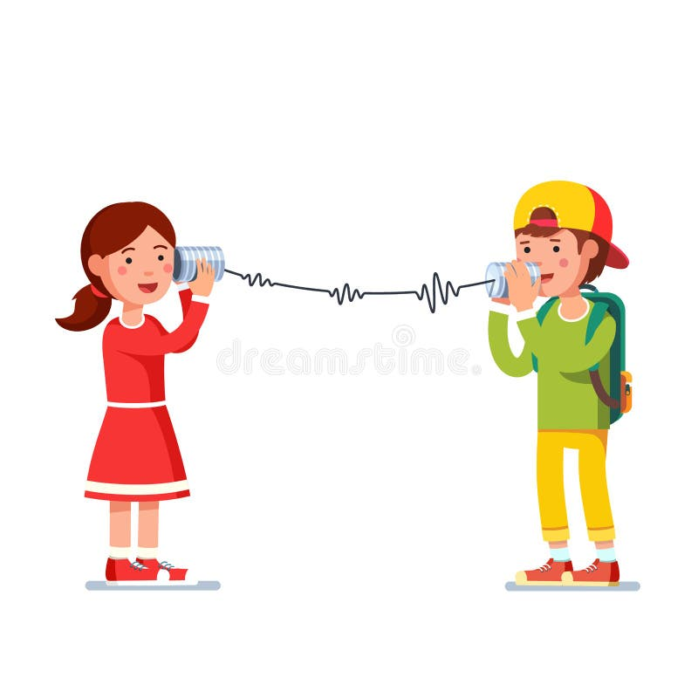
Sound Waves
How Does Sound Travel?
1
Something Vibrates
When you speak or clap, it makes tiny movements called vibrations.
2
Sound Waves Move
These vibrations travel through the air like ripples in water.
3
We Hear the Sound
The sound waves reach our ears and we hear the sound!
Just like when you drop a stone in water!

Slide 5
Audio Device
Microphone
A microphone is a special tool that hears our voice and captures sound!
How it works:
It changes the sound waves into electrical signals that can be recorded or played back.
Fun Facts:
Singers use microphones on stage
Phones have tiny microphones inside
Microphone
Teachers use microphones in big classrooms

Slide 6
Audio Device
Speaker
Speaker
A speaker is a device that makes sound louder so everyone can hear!
How it works:
It takes the electrical signals and changes them back into sound waves we can hear.
Where we see speakers:
Televisions
Phones and tablets
Music players
Classroom speakers

Slide 7
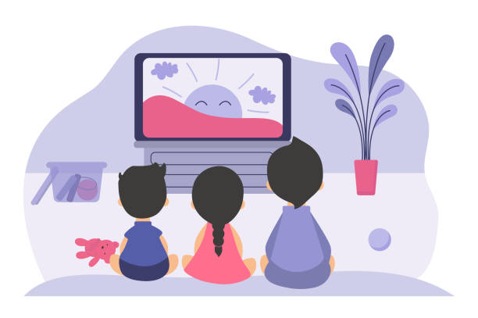
Video
Video Time!
What is Video?
Video is moving pictures that tell a story!
Examples of videos:
Cartoons and movies
Videos on phones and tablets
Educational videos
Video games
Did you know? Videos can make us laugh, learn, and explore new worlds!

Slide 8
Moving Pictures
How Does Video Work?
Picture Sequence
1
Many Pictures
A video is made of many pictures shown one after another.
2
Very Fast!
These pictures are shown very fast - about 30 pictures every second!
3
Looks Like Movement
Our eyes see it as smooth movement!
Like a flipbook animation!
Fast pictures = Moving video!

Slide 9
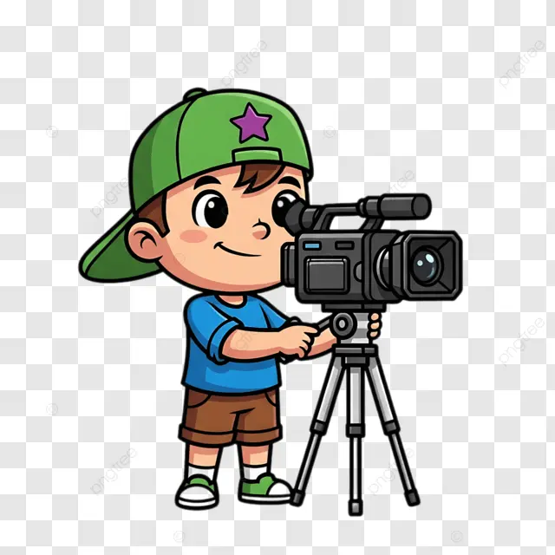
Video Device
Camera
A camera is a special tool that records video and takes pictures!
How it works:
It captures many pictures every second and saves them so we can watch later.
Different cameras:
Phone cameras
Video cameras
Camera
Digital cameras
Computer webcams

Slide 10
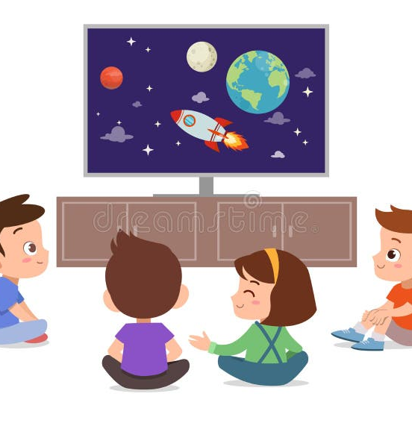
Video Device
Screen
Screen
A screen is where we watch videos and see pictures!
How it works:
It shows all the pictures from the video very fast, so we see smooth movement.
Different screens:
Television (TV)
Tablets
Phones
Computers

Slide 11
Fun Time!
Let's Have Fun!
Try these fun activities to learn more about audio and video!
Activity 1
Activity 2
Make Some Noise!
Use a Microphone!
Clap your hands and feel the vibration. Try clapping fast and slow!
If you have a toy microphone, speak into it and hear your voice louder!
Can you feel the air moving?
How does it sound different?
Activity 3
Activity 4
Watch a Video!
Make a Video!
Watch a short cartoon and count how many different sounds you hear!
Ask a grown-up to help you make a short video of yourself!
Music, voices, sound effects?
What will you say or do?

Slide 12
Great Job!
Today we learned about Audio and Video!
Sound
Video
Comes from vibrations and travels through the air. We use microphones and speakers!
Made of many pictures shown fast. We use cameras and screens!
Keep exploring and learning!
You're Awesome!

